Slide 1
Lower Bounds &
Sorting in Linear Time
Comp 122, Spring 2004

Slide 2
Comparison-based Sorting
Comparison sort
  Only comparison of pairs of elements may be used to gain order information about a sequence.
  Hence, a lower bound on the number of comparisons will be a lower bound on the complexity of any comparison-based sorting algorithm.
All our sorts have been comparison sorts
The best worst-case complexity so far is Θ(n lg n) (merge sort and heapsort).
We prove a lower bound of n lg n, (or Ω(n lg n)) for any comparison sort, implying that merge sort and heapsort are optimal.
Comp 122

Slide 3
Decision Tree
Binary-tree abstraction for any comparison sort.
Represents comparisons made by
  a specific sorting algorithm
  on inputs of a given size.
Abstracts away everything else – control and data movement – counting only comparisons.
Each internal node is annotated by i:j, which are indices of array elements from their original positions.
Each leaf is annotated by a permutation ⟨π(1), π(2), …, π(n)⟩ of orders that the algorithm determines.
Comp 122

Slide 4
Decision Tree – Example
For insertion sort operating on three elements.
1:2
≤
>
2:3
1:3
≤
≤
>
⟨1,2,3⟩
1:3
⟨2,1,3⟩
2:3
≤
>
≤
>
⟨1,3,2⟩
⟨3,1,2⟩
⟨2,3,1⟩
⟨3,2,1⟩
Contains 3! = 6 leaves.
Comp 122

Slide 5
Decision Tree (Contd.)
Execution of sorting algorithm corresponds to tracing a path from root to leaf.
The tree models all possible execution traces.
At each internal node, a comparison a_{i} ≤ a_{j} is made.
  If a_{i} ≤ a_{j}, follow left subtree, else follow right subtree.
  View the tree as if the algorithm splits in two at each node, based on information it has determined up to that point.
When we come to a leaf, ordering a_{π(1)} ≤ a _{π(2)} ≤ … ≤ a _{π(n)} is established.
A correct sorting algorithm must be able to produce any permutation of its input.
  Hence, each of the n! permutations must appear at one or more of the leaves of the decision tree.
Comp 122

Slide 6
A Lower Bound for Worst Case
Worst case no. of comparisons for a sorting algorithm is
  Length of the longest path from root to any of the leaves in the decision tree for the algorithm.
    Which is the height of its decision tree.
A lower bound on the running time of any comparison sort is given by
  A lower bound on the heights of all decision trees in which each permutation appears as a reachable leaf.
Comp 122

Slide 7
Optimal sorting for three elements
Any sort of six elements has 5 internal nodes.
1:2
≤
>
2:3
1:3
≤
≤
>
⟨1,2,3⟩
1:3
⟨2,1,3⟩
2:3
≤
>
≤
>
⟨1,3,2⟩
⟨3,1,2⟩
⟨2,3,1⟩
⟨3,2,1⟩
There must be a wost-case path of length ≥ 3.
Comp 122

Slide 8
A Lower Bound for Worst Case
Theorem 8.1:
Any comparison sort algorithm requires Ω(n lg n) comparisons in the worst case.
Proof:
From previous discussion, suffices to determine the height of a decision tree.
h – height, l – no. of reachable leaves in a decision tree.
In a decision tree for n elements, l ≥ n!. Why?
In a binary tree of height h, no. of leaves l ≤ 2^{h}. Prove it.
Hence, n! ≤ l ≤ 2^{h}.
Comp 122

Slide 9
Proof – Contd.
n! ≤ l ≤ 2^{h} or 2^{h} ≥ n!
Taking logarithms, h ≥ lg(n!).
n! > (n/e)^{n}. (Stirling’s approximation, Eq. 3.19.)
Hence, h ≥ lg(n!)
  ≥ lg(n/e)^{n}
  = n lg n – n lg e
  = Ω(n lg n)
Comp 122

Slide 10
Non-comparison Sorts: Counting Sort
Depends on a key assumption: numbers to be sorted are integers in {0, 1, 2, …, k}.
Input: A[1..n] , where A[j] ∈ {0, 1, 2, …, k} for j = 1, 2, …, n. Array A and values n and k are given as parameters.
Output: B[1..n] sorted. B is assumed to be already allocated and is given as a parameter.
Auxiliary Storage: C[0..k]
Runs in linear time if k = O(n).
Example: On board.
Comp 122

Slide 11
Counting-Sort (A, B, k)
CountingSort(A, B, k)
1. for i ← 1 to k
2. do C[i] ← 0
3. for j ← 1 to length[A]
4. do C[A[j]] ← C[A[j]] + 1
5. for i ← 2 to k
6. do C[i] ← C[i] + C[i –1]
7. for j ← length[A] downto 1
8. do B[C[A[ j ]]] ← A[j]
9. C[A[j]] ← C[A[j]]–1
O(k)
O(n)
O(k)
O(n)
Comp 122

Slide 12
Algorithm Analysis
The overall time is O(n+k). When we have k=O(n), the worst case is O(n).
  for-loop of lines 1-2 takes time O(k)
  for-loop of lines 3-4 takes time O(n)
  for-loop of lines 5-6 takes time O(k)
  for-loop of lines 7-9 takes time O(n)
Stable, but not in place.
No comparisons made: it uses actual values of the elements to index into an array.
Comp 122

Slide 13
What values of k are practical?
Good for sorting 32-bit values? No. Why?
16-bit? Probably not.
8-bit? Maybe, depending on n.
4-bit? Probably, (unless n is really small).
Counting sort will be used in radix sort.
Comp 122

Slide 14
Radix Sort
It was used by the card-sorting machines.
Card sorters worked on one column at a time.
It is the algorithm for using the machine that extends the technique to multi-column sorting.
The human operator was part of the algorithm!
Key idea: sort on the “least significant digit” first and on the remaining digits in sequential order. The sorting method used to sort each digit must be “stable”.
  If we start with the “most significant digit”, we’ll need extra storage.
Comp 122

Slide 15
An Example
Input
After sorting
on LSD
After sorting
on middle
digit
After sorting
on MSD
392 631 928 356
356 392 631 392
446 532 532 446
928 ⇒ 495 ⇒ 446 ⇒ 495
631 356 356 532
532 446 392 631
495 928 495 928
↑ ↑ ↑
Comp 122

Slide 16
Radix-Sort(A, d)
RadixSort(A, d)
1. for i ← 1 to d
2. do use a stable sort to sort array A on digit i
Correctness of Radix Sort
By induction on the number of digits sorted.
Assume that radix sort works for d – 1 digits.
Show that it works for d digits.
Radix sort of d digits ≡ radix sort of the low-order d – 1 digits followed by a sort on digit d .
Comp 122

Slide 17
Correctness of Radix Sort
By induction hypothesis, the sort of the low-order d – 1 digits works, so just before the sort on digit d , the elements are in order according to their low-order d – 1 digits. The sort on digit d will order the elements by their d^{th} digit.
Consider two elements, a and b, with d^{th} digits a_{d} and b_{d}:
If a_{d} < b_{d} , the sort will place a before b, since a < b regardless of the low-order digits.
If a_{d} > b_{d} , the sort will place a after b, since a > b regardless of the low-order digits.
If a_{d} = b_{d} , the sort will leave a and b in the same order, since the sort is stable. But that order is already correct, since the correct order of is determined by the low-order digits when their d^{th} digits are equal.
Comp 122

Slide 18
Algorithm Analysis
Each pass over n d-digit numbers then takes time Θ(n+k). (Assuming counting sort is used for each pass.)
There are d passes, so the total time for radix sort is Θ(d (n+k)).
When d is a constant and k = O(n), radix sort runs in linear time.
Radix sort, if uses counting sort as the intermediate stable sort, does not sort in place.
  If primary memory storage is an issue, quicksort or other sorting methods may be preferable.
Comp 122

Slide 19
Bucket Sort
Assumes input is generated by a random process that distributes the elements uniformly over [0, 1).
Idea:
  Divide [0, 1) into n equal-sized buckets.
  Distribute the n input values into the buckets.
  Sort each bucket.
  Then go through the buckets in order, listing elements in each one.
Comp 122

Slide 20
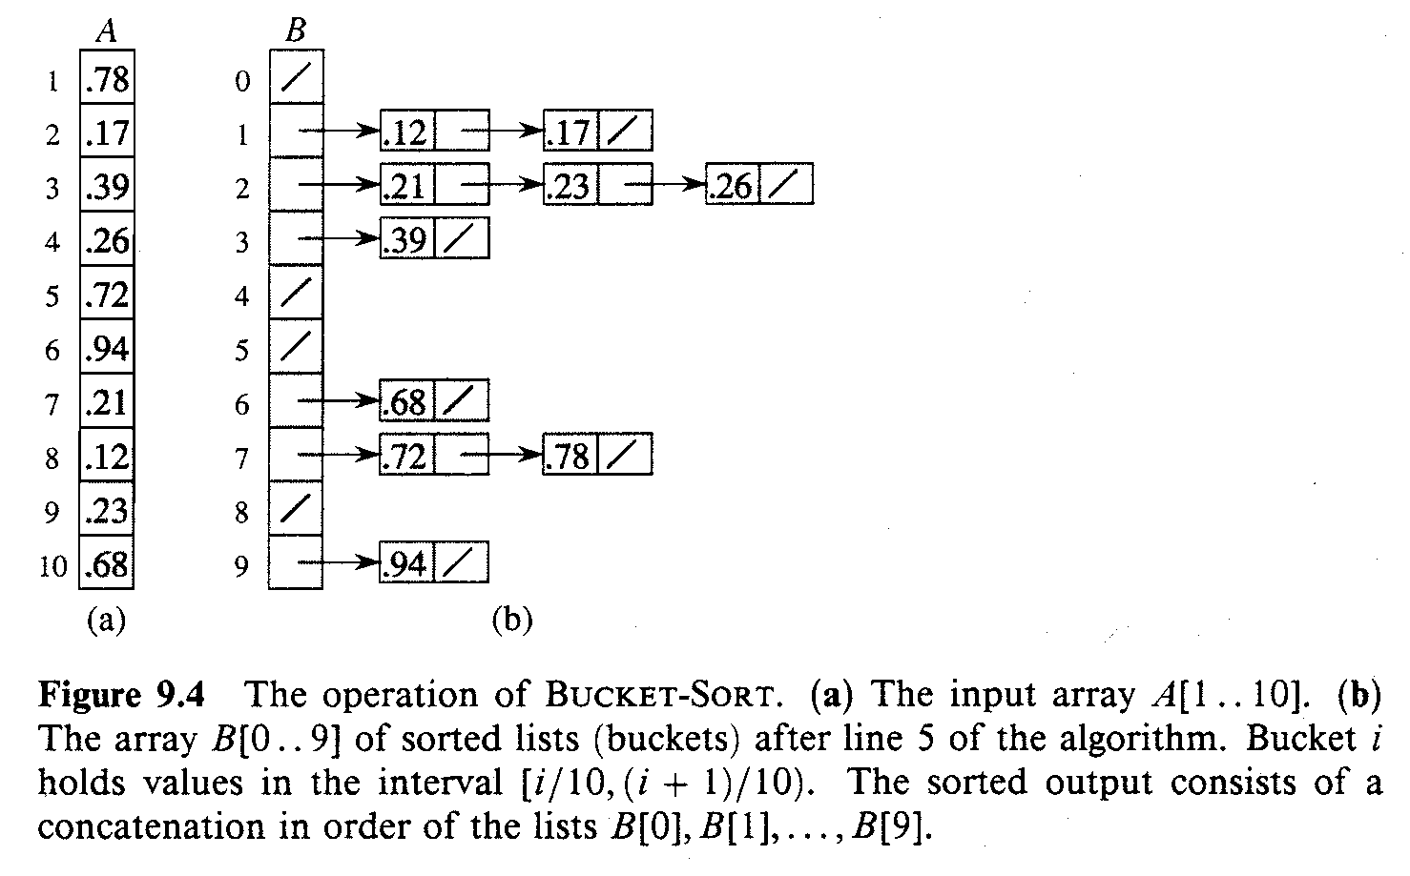
An Example
Comp 122

Slide 21
Bucket-Sort (A)
Input: A[1..n], where 0 ≤ A[i] < 1 for all i.
Auxiliary array: B[0..n – 1] of linked lists, each list initially empty.
BucketSort(A)
1. n ← length[A]
2. for i ← 1 to n
3. do insert A[i] into list B[ ⎣nA[i]⎦ ]
4. for i ← 0 to n – 1
5. do sort list B[i] with insertion sort
concatenate the lists B[i]s together in order
return the concatenated lists
Comp 122

Slide 22
Correctness of BucketSort
Consider A[i], A[j]. Assume w.o.l.o.g, A[i] ≤ A[j].
Then, ⎣n × A[i]⎦ ≤ ⎣n × A[j]⎦.
So, A[i] is placed into the same bucket as A[j] or into a bucket with a lower index.
  If same bucket, insertion sort fixes up.
  If earlier bucket, concatenation of lists fixes up.
Comp 122

Slide 23
Analysis
Relies on no bucket getting too many values.
All lines except insertion sorting in line 5 take O(n) altogether.
Intuitively, if each bucket gets a constant number of elements, it takes O(1) time to sort each bucket ⇒ O(n) sort time for all buckets.
We “expect” each bucket to have few elements, since the average is 1 element per bucket.
But we need to do a careful analysis.
Comp 122

Slide 24
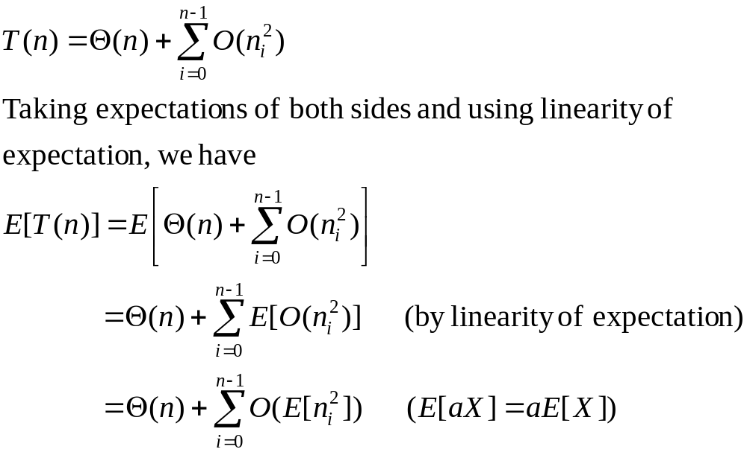
Analysis – Contd.
RV n_{i} = no. of elements placed in bucket B[i].
Insertion sort runs in quadratic time. Hence, time for bucket sort is:
(8.1)
Comp 122

Slide 25
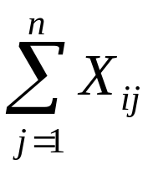
Analysis – Contd.
Claim: E[n_{i}²] = 2 – 1/n.
Proof:
Define indicator random variables.
  X_{ij} = I{A[j] falls in bucket i}
  Pr{A[j] falls in bucket i} = 1/n.
  n_{i} =
(8.2)
Comp 122

Slide 26
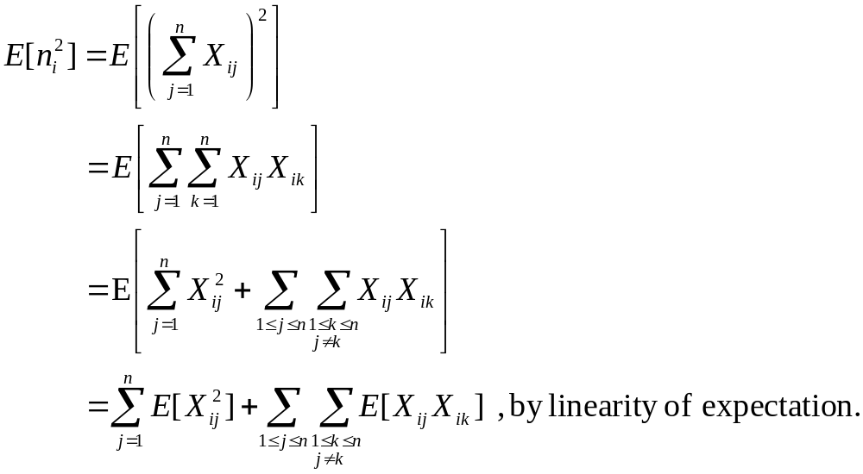
Analysis – Contd.
(8.3)
Comp 122

Slide 27
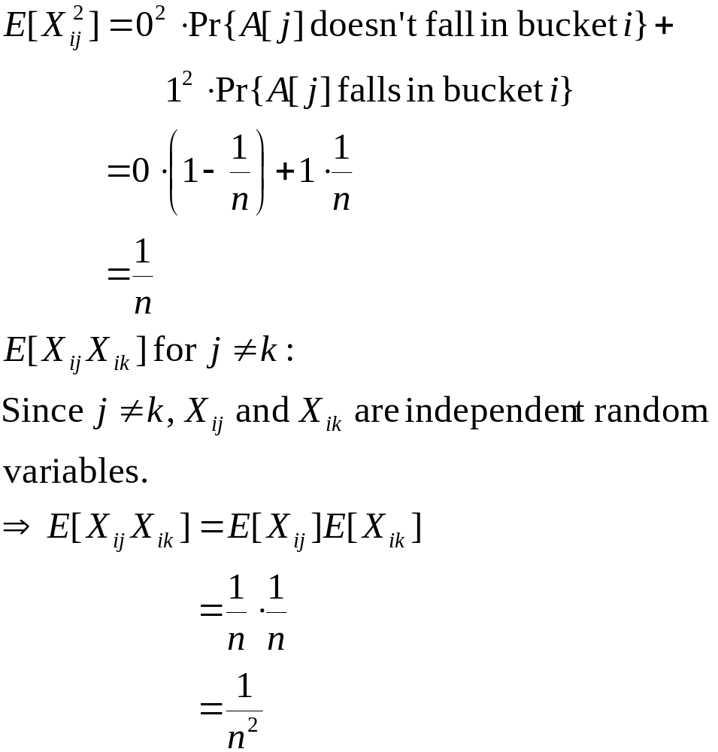
Analysis – Contd.
Comp 122

Slide 28
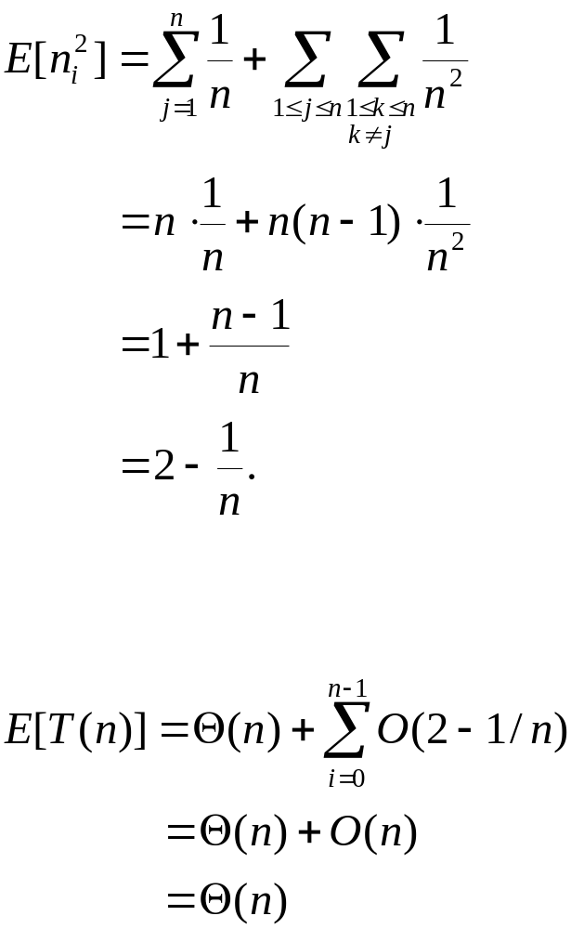
Analysis – Contd.
(8.3) is hence,
Substituting (8.2) in (8.1), we have,
Comp 122

